Slide 1
שם ביה"ס, רשות: | מקיף ז', אשדוד
שם המורה: | אליזה
שם המדריכה: | יהודית שוורץ
שם הפעילות: | Exploring the world

Slide 2
you are going to make a research of different countries around the world
Exploring the world

Slide 3
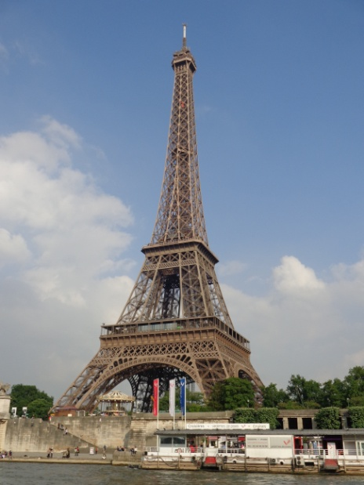
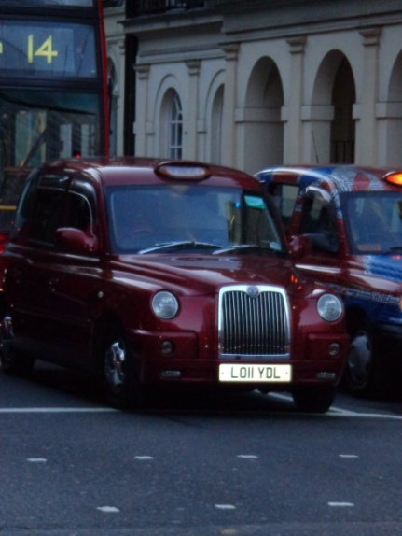
Choose one of the countries from the list below
Turkey
France
Italy
Poland
Ukraine
Romania
Brazil
Ethiopia
China

Slide 4
The research will be divided into two parts. During the first part you will have to study the countries according to the criteria brought to you below. You must explore all of them.
The second part of your research will be devoted to studying the criteria of your choice out of a list of criteria.
The language spoken there
Traditional food
Traditional holidays
Traditional music and dances
Two famous tourist attractions
A map of the country

Slide 5
Optional criterion
You should choose two more aspects to investigate out of this list.
Traditional
Clothes
Native Famous people
Symbols which are associated with the country
A song that is dedicated to the country
Audio file of someone speaking the language of the country

Slide 6
Instructions
Create a Google Docs Presentation.
The presentation should include 10 slides.
1st slide: the cover page
2nd slide: the introduction
3rd – 10th slides: the investigated criteria

